Slide 1

ML-Miscellaneous PDF & CDF , Kernel Density Estimation ,Machine Learning Model Inference, Feature Importance

Slide 2
Table of Contents
PDF & CDF
Kernel Density Estimation
Machine Learning Model Inference
Feature Importance

Slide 3
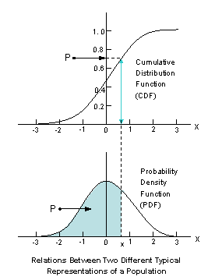
Probability Density Function (PDF)
Probability density function (PDF) is a function that describes the likelihood of a continuous random variable taking a particular value within a certain range. In other words, it is a mathematical function that represents the probability distribution of a random variable.

Slide 4
Probability Density Function (PDF)
The PDF is a non-negative function, and its integral over the entire domain is equal to 1.
The area under the PDF curve between any two values of the random variable represents the probability of the random variable taking a value within that range.
The higher the PDF at a particular value of the random variable, the more likely that value is to occur.

Slide 5
Probability Density Function (PDF)
The PDF is an important concept in probability theory and statistics, and is used to model many natural phenomena, such as the heights of people in a population, the temperatures measured at a particular location, and the stock prices of a company.
It is also used to perform calculations involving continuous random variables, such as finding the expected value, variance, and moments of the variable.

Slide 6
Probability Density Function (PDF)
Steps for calculation of PDF
Identify the probability distribution of the random variable.
Determine the parameters of the distribution, if any. For example, the normal distribution has two parameters, the mean and standard deviation.
Write down the PDF formula for the distribution. For example, the PDF for the normal distribution with mean μ and standard deviation σ is: f(x) = (1/(σ√(2π))) * e^(-((x-μ)^2)/(2σ^2)) where e is the mathematical constant e, which is approximately equal to 2.71828.
Substitute the parameter values and the specific value of the random variable into the PDF formula to obtain the probability density at that value.

Slide 7
Probability Density Function (PDF)
For example, suppose you want to calculate the PDF of a normally distributed random variable with mean μ = 10 and standard deviation σ 2 at x = 12. Plugging these values into the formula above, we get:
f(12) = (1/(2√(2π))) * e^(-((12-10)^2)/(2(2^2))) = 0.120985
So the probability density at x = 12 is 0.120985.

Slide 8
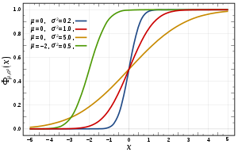
Cumulative Density Function (CDF)
The cumulative density function (CDF) is a function that describes the probability that a continuous random variable X is less than or equal to a certain value x. It is defined as:
F(x) = P(X ≤ x)
In other words, the CDF gives the cumulative probability distribution of the random variable X. It is a non-decreasing function that ranges from 0 to 1, and its value at any point x represents the probability that X takes on a value less than or equal to x.

Slide 9
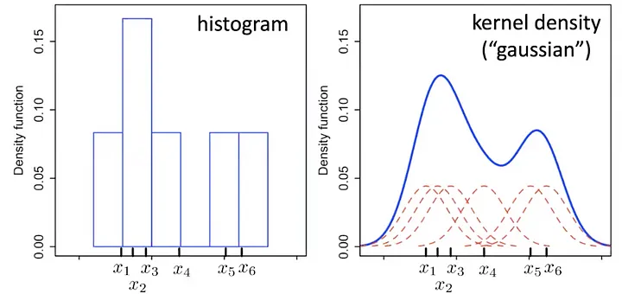
Kernel Density Estimation
Parametric models have a fixed number of adaptable parameters, independent of the amount of data. Ex: Logistic regression, K-means clustering.
Non-parametric models have a variable number of parameters i.e. parameters change to adapt to the amount of data. In simple terms in order to make predictions the models looks at some(mostly all) data points in order to make a decision. Ex: Kernel Density Estimators, SVMs, Decision Trees.

Slide 10
Kernel Density Estimation
Kernel Density Estimation is smoothening the data by convolving each point x with some ‘kernel’. Each point is represented as the center for a kernel density function and the final curve is normalized convolution(sum) of all kernels at that point.

Slide 11
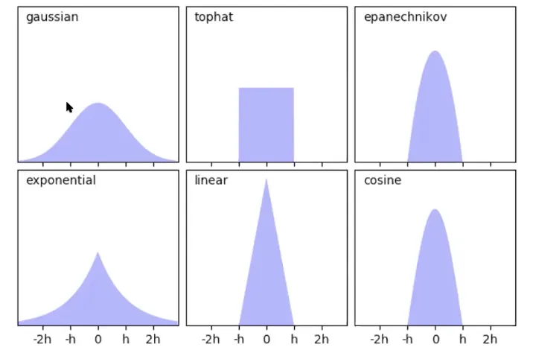
Kernel Density Estimation
The following are the Type of Kernel Functions

Slide 12
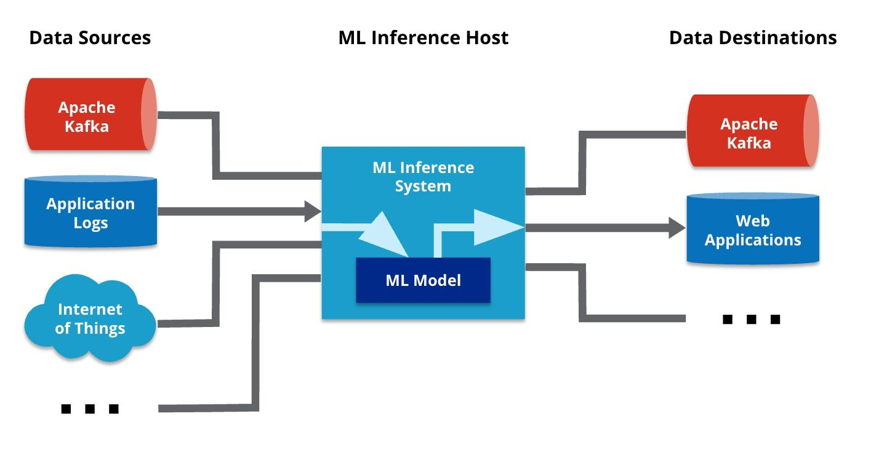
Model Inferencing
Inference in machine learning refers to the process of using a trained model to make predictions or draw conclusions about new data. In other words, it is the process of using a machine learning model to perform a task that it was designed for, such as classification or regression, on new data points that were not part of the training set.

Slide 13
Model Inferencing
The process of inference typically involves passing the new data through the trained model, which generates a prediction or output based on the patterns it has learned from the training data. This prediction can then be used for various purposes, such as making decisions, generating insights, or automating tasks.

Slide 14
Model Inferencing
The quality of the inference depends on the accuracy and generalization ability of the trained model, as well as the quality and representativeness of the new data. In some cases, additional processing or pre-processing may be required to ensure that the new data is in a suitable format for the model to make accurate predictions.

Slide 15
Model Inferencing
Overall, inference is a critical component of machine learning, as it enables us to apply trained models to real-world problems and make use of the insights and predictions that they provide.

Slide 16

Inference VS Validation
Inference is the process of using a trained model to make predictions or draw conclusions about new data points that were not part of the training set. It involves applying the model to new data and generating outputs or predictions based on the patterns learned from the training data.
On the other hand, validation is the process of evaluating the performance of a machine learning model on a held-out set of data that was not used in training. The purpose of validation is to assess the generalization ability of the model, i.e., how well it can make accurate predictions on new, unseen data.

Slide 17
Inference VS Validation
The key differences between inference and validation are as follows:
Purpose: Inference is used to make predictions on new data, while validation is used to evaluate the performance of a model on a held-out set of data.
Data: Inference involves new, unseen data that was not used in training, while validation uses a held-out set of data from the same distribution as the training set.

Slide 18
Inference VS Validation
Process: Inference involves applying a trained model to new data and generating outputs or predictions, while validation involves evaluating the performance of the model on the held-out set of data.
Metrics: Inference may use different metrics to evaluate the performance of the model, depending on the task, while validation typically uses common metrics such as accuracy, precision, recall, and F1 score.

Slide 19

Feature Importance
It assigns the score of input features based on their importance to predict the output. More the features will be responsible to predict the output more will be their score. We can use it in both classification and regression problem.Suppose you have a bucket of 10 fruits out of which you would like to pick mango, lychee,orange so these fruits will be important for you, same way feature importance works in machine learning.I

Slide 20
Feature Importance
Permutation Feature Importance
It is Best for those algorithm which natively does not support feature importance . It calculate relative importance score independent of model used.It is one of the best technique to do feature selection.lets’ understand it

Slide 21
Feature Importance
Permutation Feature Importance Steps
Step 1 : - It randomly take one feature and shuffles the variable present in that feature and does prediction .
Step 2 :- In this step it finds the loss using loss function and check the variability between predicted and actual output.
Step 3:- Returns the variable of feature into original order or undo reshuffle.
Step 4 :- Does the above three procedure with all the features present in dataset.
Step 5 :- Final important features will be calculated by comparing individual score with mean importance score.

Slide 22
Feature Importance
Coefficient as Feature Importance
In case of linear model (Logistic Regression,Linear Regression, Regularization) we generally find coefficient to predict the output.l

Slide 23
Feature Importance
Why Feature importance is so important ?
Feature importance gives us better interpretability of data.let’s understand Interpret-ability.
Suppose you have a dataset of hospital now owner want to know which kind of symptomatic people will again come to hospital.
How each disease(feature) make them profit.What is the sentiment of people about treatment in this hospital these all are known as interpretability.
It also helps us to find most important feature for prediction.

